Slide 1
ENSE 471, Milestone 3
Walmart Greeters
Taylor Petrychyn, Daris Lychuk, Priscilla Chua
April 10, 2019
Notes:
Daris

Slide 2
Team (re)introductions
Team members
Daris Lychuk 4th year SSE student
Taylor Petrychyn 4th year SSE student
Priscilla Chua 4th year SSE student
What’s your team name?
Walmart Greeters
Notes:
Daris

Slide 3
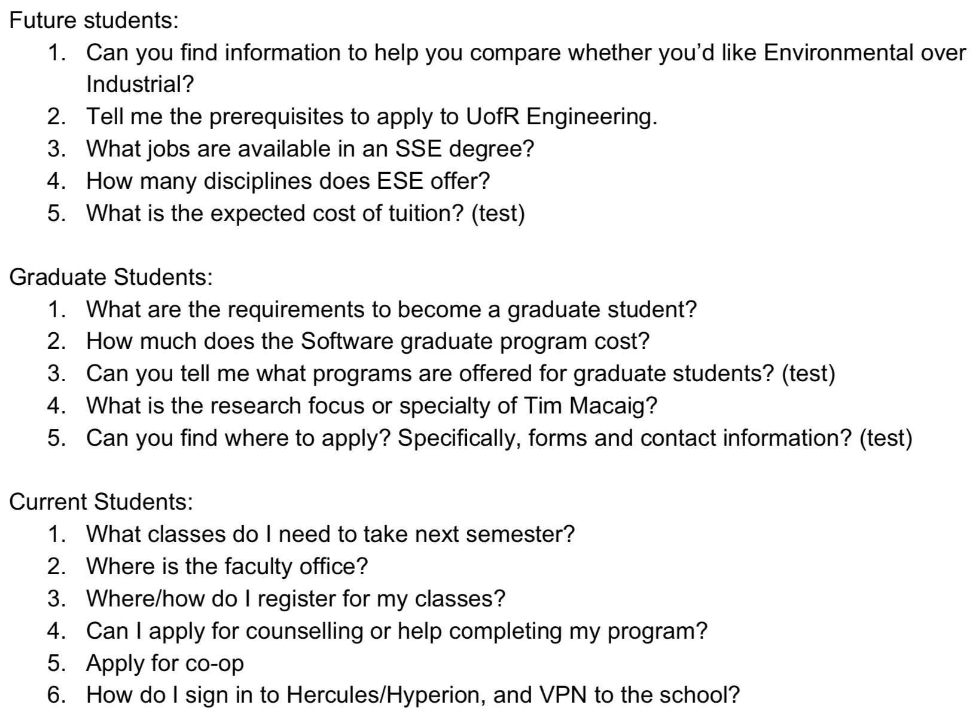
Balsamiq Demo
Notes:
Daris

Slide 4
Balsamiq prototype
Concepts discussed in class
Proximity - Sidebar links take away from Engineering category
Similarity - Main squares for most important tasks
Sub-conscious interaction - Click the box that describes your needs
Signifiers - Instructing user to select the box that describes their role
Notes:
Daris

Slide 5
User Feedback
What techniques did we use to evaluate our design?
Asked customers to go through usability test questions
Asked if design format made sense
Observed customers emotions
What didn’t work so well (if any)?
Some links were missing or assumed self explanatory
What did our target customers say?
Clarify link names (for faculty vs. about faculty)
Liked how quick links were context specific
Liked content specific categories
Quick links worked consistently/predictably

Slide 6
Cascade Server integration?
Pros
Kept link locations similar
Mostly just moving some things (Same page format/content)
Cons
We do not envision a seamless map from Balsamiq to Cascade
Carousel may not be feasible
HTML/Javascript needed in order to design

Slide 7
Comments & Next Steps
We feel as a team we have achieved our goals of our design. Our customers found it fairly easy to navigate based on the usability questions asked.
Considering constraints of Cascade Server and beyond as based on all experiences your team had and the data, info, knowledge your Team obtained throughout project activities
Regardless of Cascade Server’s restraints, proper navigation(breadcrumbs), carousel, easy maintainability (no duplication of links)

Slide 8

GitHub “stamp of approval”
We approve it!
Notes:
Taylor

Slide 9
Group Reflection
How did you feel about this project? What did you like about it? What did you dislike?
Cool idea we got to work on stuff we use daily
Lacked complexity. Was repetitive work copying links rather than creative design
What did you learn about yourself as you collaborated and worked through this project?
We like getting feedback from customers/users throughout design, it keeps the vision on track
Notes:
Taylor

Slide 10
Group Reflection Continued
How will you use what you have learned going forward?
Usability questions are valuable in gaining insight
Quick mockups save time in the long run
Fast feedback cycle works well
Balsamiq is a nice mockup tool
Notes:
Taylor

